Slide 1


Slide 2

The purpose and goals of normalisation.
Removing repeating groups
Normalisation vs Performance

Slide 3

Normalisation is process for assigning attributes to entities
  Reduces data redundancies (unnecessary duplication).
  Helps eliminate data anomalies (inconsistencies).
  Produces controlled redundancies to link tables using foreign keys.
ER modelling yields good table structures, but …
Normalisation promotes further refinement.
De-normalisation (reversal of normalisation)
  Produces a lower normal form (with fewer tables)
  Only purpose is to increase performance (reduces joins/relationships between tables)

Slide 4

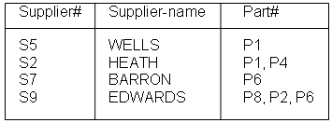
A fundamental rule of database design is that each row/column intersection of a database table holds only a single attribute value. The table below breaks this rule in that the second and fourth row contains multiple values for the attribute Part#
In this example, Part# is described as a repeating group. We cannot store data contained in a repeating group. Repeating groups are eliminated by splitting the table into two, as shown on the next slide.
Supplier-Part

Slide 5

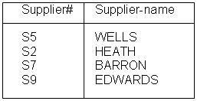
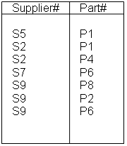
Supplier
Supp-Part
By splitting the table into two, the repeating group attribute (Part#) is placed in one table (Supp-Part), together with Supplier#. We need the values for Supplier# otherwise information would be lost as to who supplies which Part#. The rest of the attributes are stored in another table (Supplier).

Slide 6

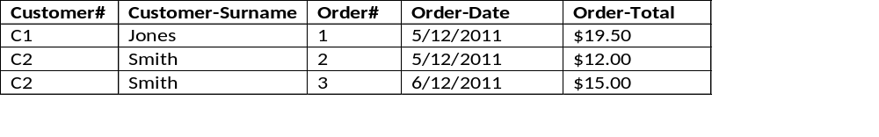
Customer-Orders
The Order details for customers in the above table is a repeating group (see customer C2) – but this fact has been ‘hidden’ because the order details have been spread over two rows for customer C2. However, notice that the Customer# and Customer-Surname appears twice, once for each order placed by that customer. Any data recorded more than once in a database is known as redundant data (it has been unnecessarily duplicated).
As shown on the previous slide, the repeating group is eliminated by table splitting – Orders are placed in one table and Customers in another (see next slide).

Slide 7

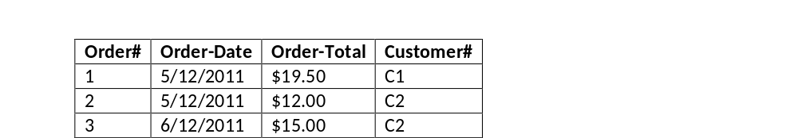
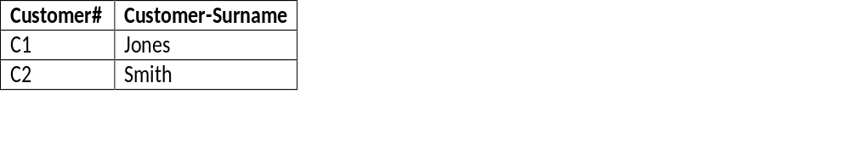
Customers
Orders
To eliminate the repeating group (the customer’s order details), we split the tables in two. Now, all customer details are recorded in one table and their orders are recorded in another.
Notice that as before, we need to cross-reference each order to the customer who placed that order by including Customer# in the Orders table. Without this column, we lose information – i.e. which customer placed that order.
Customer# in the Orders table is a foreign key.

Slide 8

Normalisation should be part of the design process
Entity Relationship Diagrams provide the macro view
Normalisation provides micro view of entities
  Focuses on characteristics of specific entities
  May yield additional entities
Difficult to separate normalisation from Entity Relationship modelling

Slide 9

Normalisation is one of many database design goals
Normalised table requirements
  Additional processing
  Loss of system speed
Normalisation purity is difficult to sustain due to conflict in:
  Design efficiency
  Information requirements
  Processing speed
De-Normalisation involves producing a lower normal form for a portion of the database to improve performance i.e. introduces controlled redundancy into the database design by using fewer tables to store data.

